Slide 1
EXL CAMPUS HIRE PROGRAMME
Capstone Project Presentation
CX Micro-Intent Router
A governed triage layer that routes each support message to the right agent — or a human
Track / Batch GenAI Customer Experience
TEAM (MAX 3)
Abhishek Tiwari
Priyanka Verma
Rishita Rathi
Presentation Date 07 Aug 2026
Notes:
We built a triage layer that sits in front of a support bot and decides — before any expensive model runs — whether a message should be answered, handled with empathy, treated as a transaction, or sent to a human. We call it the CX triage nurse: it doesn't try to cure everything, it sorts correctly and knows when not to act.

Slide 2
2
Problem & Business Context
Capable models aren't the blocker — trust is. Here's what that costs CX teams today.
INDUSTRY & FUNCTION
THE PROBLEM
CURRENT-STATE COST
Regulated customer experience — telecom, banking, finance — where a wrong action is a compliance event, not just a bad reply
High-volume contact-centre support: refunds, account changes, cancellations and complaints
Owned by CX teams answerable for cost, CSAT, deflection and audited compliance
Over-automation: one do-everything bot hallucinates answers, over-promises ('I've refunded you') and takes unsafe account actions
Under-automation: routing every contact to a human is slow, costly and doesn't scale
Neither approach knows when it should not act — the judgement that keeps customers safe
The real blocker isn't capability, it's trust: no safety guarantees, no audit trail
The levers CX teams are measured on today:
Cost per contact climbs when humans handle everything, even the trivial
Handle time balloons — escalated humans restart each case cold, with no context
Compliance incidents from unsafe actions, invisible without an audit trail
Churn — angry customers spotted only after they've decided to leave
EXL Campus Hire Programme · Capstone Project Presentation
Slide 2 of 8
Notes:
Models are good enough today. What keeps enterprises stuck in 'suggest-to-a-human' mode is trust — a bot that invents a refund policy or says 'I've refunded you' when it hasn't is a brand and compliance risk. The missing piece isn't a smarter answer; it's a governed decision about whether the bot should act at all.

Slide 3
3
Solution Overview
A cheap triage layer that routes and reads tone — deterministic code decides money, access and escalation.
WHAT THE SOLUTION DOES
WHO USES IT & HOW
A lightweight router reads intent, confidence and tone in one cheap model call
Hands each message to exactly one specialist — FAQ, Empathy, Transaction — or a human
Escalates when unsure, and fast-tracks angry or distressed customers straight to a person
FAQ answers only from a knowledge base, cites its source, and abstains on no match
Success criteria the team set:
Every money, access and escalation decision lives in deterministic code the model can't override
CX and contact-centre agents — and the customers messaging them on any channel
It sits as a governed front door in front of the existing support bot
Agents get only the cases that truly need a human, each with a ready-made brief
SCOPE
In scope: routing, RAG-grounded FAQ, empathy, refund proposals, guardrails and full audit logging
Out of scope: real payment execution, conversation memory, and measured accuracy (harness built, not run)
The contrarian bet: a cheap, separate, governed front door — not one self-governing mega-agent
EXL Campus Hire Programme · Capstone Project Presentation
Slide 3 of 8
Notes:
Instead of one big agent doing everything, a tiny classifier decides where each message goes. The industry is moving toward a single self-governing agent — we bet the opposite. The model reads intent and tone; code decides money, access, and escalation. That separation is the whole idea.

Slide 4
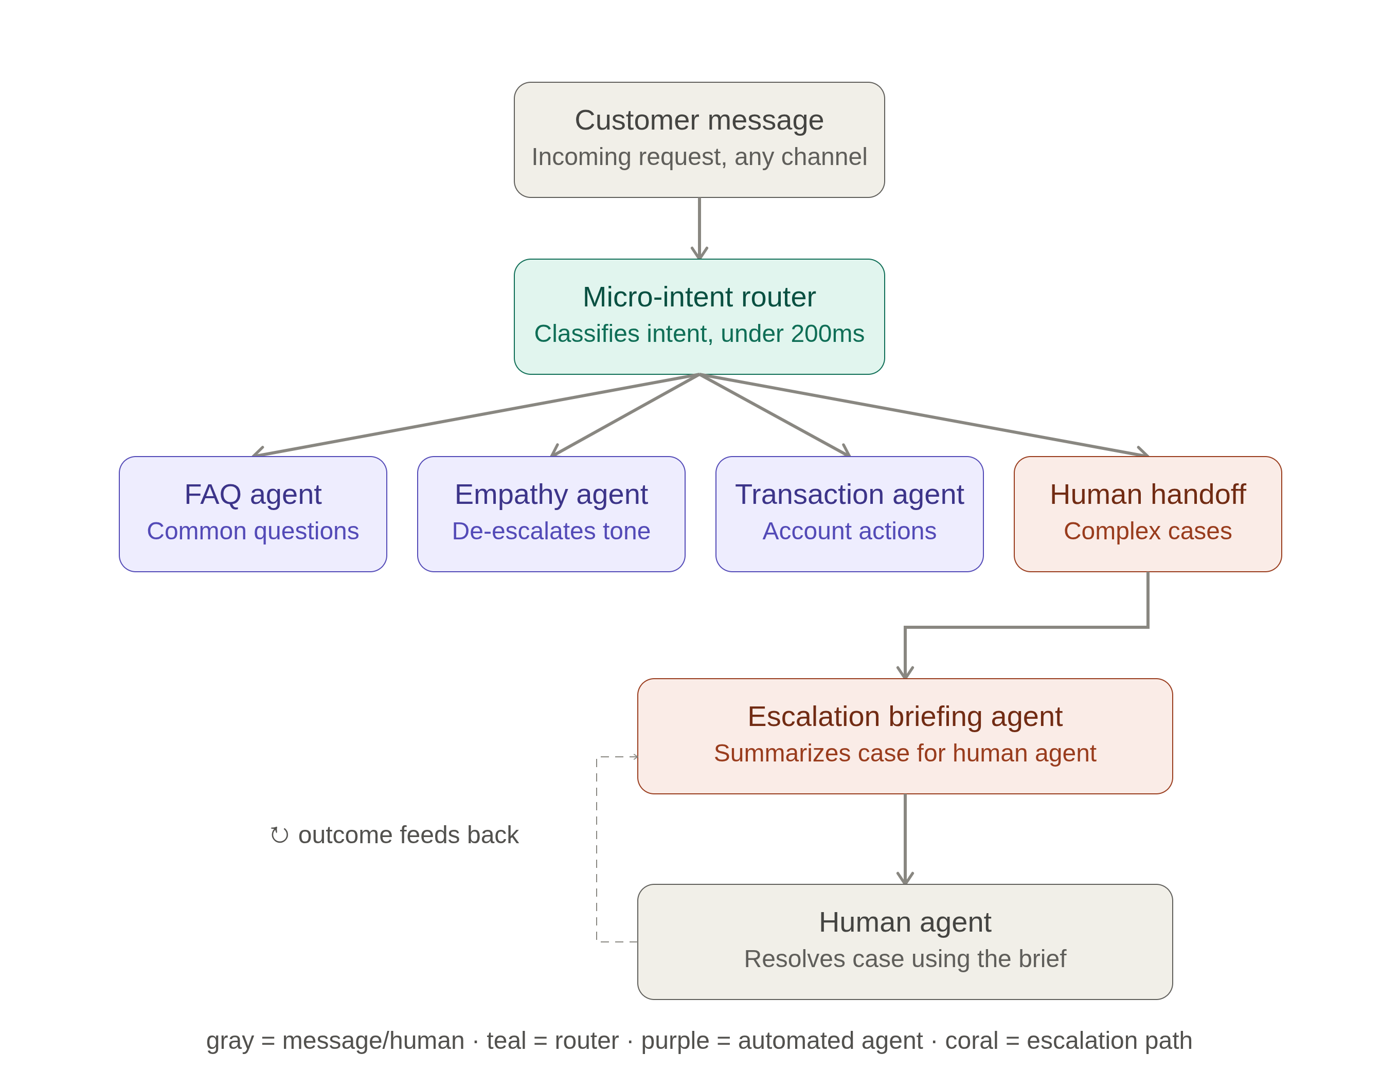
4
Architecture & Tech Stack
Six governed layers per message — the model proposes, deterministic code decides.
TECH STACK
OpenRouter for model access — cheap Haiku 4.5 routes, Sonnet 4.6 runs the agents
Pydantic structured output · sentence-transformers RAG · FastAPI dashboard · JSON stores
ARCHITECTURE DIAGRAM
KEY DESIGN DECISIONS
Model proposes, code decides — the $2k limit, ownership and idempotency are plain Python, impossible to prompt-inject around
A cheap Haiku router gates the expensive Sonnet agents, so trivial traffic never pays for a frontier model
EXL Campus Hire Programme · Capstone Project Presentation
Slide 4 of 8
Notes:
Every message flows through six layers. The key line: model proposes, code decides. The router is cheap Haiku; it only spends the bigger Sonnet agents when the case earns it. The $2k limit, ownership check, and idempotency are plain Python — cheaper, faster, and impossible to jailbreak around.

Slide 5
5
Solution in Action
The same governed brain across live scenarios — money, access, tone and intent.
SCREENSHOT — Chat + live decision trace
SCREENSHOT — Refund routed by real order value
The live dashboard — orders on the left, chat in the centre, and a real-time decision trace on the right: intent, sentiment, confidence, cost and reason
Refund ORD-1001 → auto-approvable. The $79.99 amount is read from the order record, never from the customer's message
Same customer, ORD-1003: at $2,499 it exceeds the $2,000 limit and is routed to a human for approval
Refund ORD-1002 → blocked: it's another customer's order, so the ownership check stops it before any action
The mic-drop: 'How do I cancel?' → FAQ, but 'Cancel now.' → Transaction. Intent, not keywords, decides the route.
EXL Campus Hire Programme · Capstone Project Presentation
Slide 5 of 8
Notes:
Watch the decision trace. Same customer, two orders — one auto-approves, one needs a human, purely on the real order value. Try to refund someone else's order and it's blocked. Send a furious message and it's fast-tracked to a person. The model never touches money — it proposes, the code decides. Do this LIVE if the connection is stable; otherwise run demo.py --replay as backup.

Slide 6
6
Outputs & Evidence
Every decision logged and defensible; every red-team attack caught.
METRICS
Cost: ~$0.004–0.007 per message
Latency: ~6–20s today, two LLM calls
Routing accuracy: harness built, not yet run
Red-team: 8 / 8 integrity attacks caught
Audit: one JSON line/message, PII redacted
SCREENSHOT — view_logs.py audit trail
SCREENSHOT — churn-risk fast-track
view_logs.py — a blocked ownership attempt, logged with actor, intent, tone, cost and outcome
A furious message flagged as churn-risk and fast-tracked to a human, captured in the same trace
BEFORE VS AFTER
WORKING VS MOCKED
An ungoverned bot that might act unsafely → a governed front door where every decision is deterministic and auditable
Fully working: routing, RAG cite/abstain, guardrails, policy, ownership, idempotency, audit · Mocked: live payment execution
EXL Campus Hire Programme · Capstone Project Presentation
Slide 6 of 8
Notes:
Everything is logged and defensible — this is what a regulated CX team needs. We red-teamed our own agent: you can't refund someone else's order, you can't lowball the amount, you can't prompt-inject it into approving money. Here's the audit trail. We won't quote an accuracy number we haven't earned — the eval harness is built but not yet run.

Slide 7
7
Business Value & Scale-Up Path
Cost, safety and churn value — with an honest path to enterprise grade.
$0.005
8 / 8
6
Avg cost per governed message
Red-team attacks blocked
Governance layers per message
BASIS OF ESTIMATE
PATH TO ENTERPRISE GRADE
KNOWN GAPS
Cost measured live per message; the cheap router gates costly agents, and deterministic checks cost zero model calls
8 red-team tests — IDOR, amount-spoofing, injection, social-engineering, idempotency — all caught
Maps onto EXL CX and contact-centre service lines, behind existing interfaces
Measure labelled routing accuracy and a cost/latency baseline vs. one big agent
Replace the LLM router with an embedding classifier for sub-200ms triage
Add a circuit breaker and capacity governor for resilience under load
Extend to voice on the same governed brain; wire real CRM / payments
Latency ~6–20s today; routing accuracy not yet measured
No conversation memory — routing is per message, so cross-turn context is lost
Transactions are proposed, not executed — no live payments or CRM writes yet
EXL Campus Hire Programme · Capstone Project Presentation
Slide 7 of 8
Notes:
The value is cost, safety, and catching at-risk customers early. Next steps: measure routing accuracy honestly against a one-big-agent baseline, make the router sub-200ms with embeddings, add load resilience, and extend to voice — same governed brain, any channel. Nothing here is a rewrite; it's the same architecture, hardened.

Slide 8
Thank You
Questions & Discussion
Team Abhishek Tiwari· Priyanka Verma · Rishita Rathi
Track / Batch GenAI Customer Experience
EXL Campus Hire Programme · Capstone Project Presentation
Slide 8 of 8
Notes:
To sum up: the value isn't a better answer, it's knowing when the bot should not act — cheaply, safely, and auditably. Repo: github.com/abhishek-tiwari-at/capstone-cx-router. Happy to take questions.

